Slide 1

Postmodernism and tolerance among young people in Switzerland
Bernhard Rotzer | 07-27-2022 | PH-VS

Slide 2
Contents
Swiss context
Postmodernism
SINUS Youth and Shel Youth Study
Methodology
Findings
Conclusion

Slide 3

From a Christian Switzerland to a Switzerland of Diversity
Modern Switzerland was founded in 1848, the Swiss Confederation was Protestant and Catholic in its worldview (cf. Maissen, 2010, p. 200 ff.).
Heterogenization push due to ethnicity, language diversity and religious diversity.
Digital world. This opens doors to the wider world and a further heterogenization of world views.
While Switzerland was still dominated by a differentiated Christian society at the beginning of the 20th century, further social differentiation emerged from the second half of the same century onward, and the path from modernity to postmodernity can be traced well here.

Slide 4
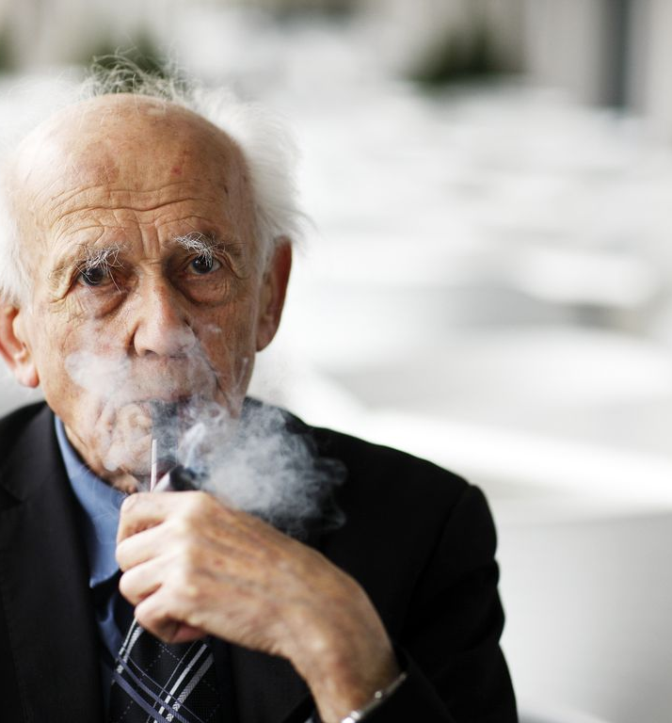
Postmodernism
Zygmunt Bauman established himself as a resolute opponent of uniform universalism and, in contrast, pleaded for an acceptance of many forms of life as the highest good.
The main characteristic of postmodernism is the acceptance of diversity, in which not only pluralism is recognized as a social reality, but also great space is given to individualism (Zima, 2014, p. 69).

Slide 5

Prior studies and research question
SINUS Youth Study 2020
The values of German young people between the ages of 14 and 17.
Among the younger generation, binding social values such as family, altruism and tolerance are highly valued
"The first priority is equal rights for people and poverty of course (male, 15 years [...]“
Shell Youth Study 2019
Confirms the importance of tolerance among young people

Slide 6

Research questions
Are humanistic values in the sense of postmodernism as firmly anchored among Swiss young people as they are among those in Germany?
And are young people interested in the postmodern values of social plurality, or are there constructs of modernity among young people in which social homogeneity is advocated and certain groups are excluded?

Slide 7

Method
36 school assignments of 16- and 17-year-old adolescents between 2020 and 2021
bilingual school (German/French) in Switzerland
Task of writing a text about a person of their choice from the world of ethics and religions in history or the present
What influence the chosen person can have in the 21st century
Grounded theory according to Anselm Strauss

Slide 8

Important personalities
Christian protagonists predominate the sample
Mother Teresa (4 texts)
Dalai-Lama (3 texts)
Pope Francis and Moses (2 texts each)
Persons from politics are in second place, whereby the majority of them can be described as activists
Martin Luther King and Rosa Parks were described the most
Nelson Mandela (2 texts)

Slide 10
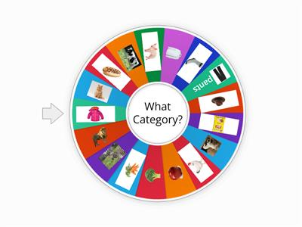
Categories
The topics
"racism" and "charity" predominate.

Slide 11
Racism
The young people appreciate and admire the courage, tireless struggle and commitment to the disadvantaged:
"I think it is courageous that Martin Luther King fought strongly against racial hostility. I admire him for wanting to show people that all people are equal" (T_19).
It is important to the young people that they stand up for equality today and that inequalities, for example between People of Color (PoC) and whites, still exist.
"She [Rosa Parks] would think that there is still a long way to go, but it is positive, and Rosa Parks would be proud of the fact that she literally changed the way things are seen, especially in relation to black people" (T_05).

Slide 12
Charity
In this category, the name Mother Teresa stands out
"I also recognize myself in her values, and I think the life and deeds she accomplished are wonderful" (T_17) or "Finally, I would like to say that in my opinion Mother Teresa was a very good person and is a role model to follow" (T_09).
Pope Francis, Pierre Abbé, Elizabeth of Hungary or Zacchaeus. The importance of solidarity and altruism is exemplified by a quote about Elizabeth of Hungary: "This touched me very much, because I would like to help the poor when I grow up. I would like to go to another country to help people who really need it. I think it is very important, and we need more people like Elisabeth" (T_03). Common to all texts is that equality between people is strived for and disadvantaged people should be helped
Pierre Abbé: "We must fight against injustice in our society!" (T_32).

Slide 13
Feminism
Gisèle Halimi
Emmeline Pankhurst
Rosa Parks
"I chose this person because, first of all, she was a woman and women were not very respected in her time. Also, she was of color and eventually contributed to the struggle for gender equality" (T_20).
"Gisèle Halimi's final message to women: 'Organize, mobilize, be in solidarity,' by saying this, she makes us understand that we women need to support each other. We are not doing it enough" (T_16).

Slide 14
LGBTQIA+
Concerns of the LGBTQIA+ community were mentioned only twice
Barack Obama's advocacy for equal rights for same-sex partnerships or for homosexual soldiers. Aristotle is described in the historical context of a more "open" Greek civilization regarding homosexuality and that he was against homophobia.

Slide 15
Postmodern Values
The second largest category, "charity," follows these postmodern tendencies, because with plurality, ambivalences are also possible and desirable, and those who are "other" from a modern perspective are now no longer merely tolerated, but integrated into society in solidarity.
“[…] the young people, a strong interest in altruistic action, be it with regard to racism, feminism or charity”.

Slide 16
This study showed that Swiss young people accept social heterogeneity and, where it is not tolerated, even demand it.
Further, the students were interested in the fight against poverty. In addition, feminism highlighted women's equality as an important issue, These representations reveal a postmodern mindset among young people that embraces universal diversity and does not stop at nations or cultures. "Postmodernism is incapable of exclusion.

Slide 17
Conclusion for teaching
Intercultural learning
Inclusion
Cultural comparisons
the starting point for intercultural education lies in the self-reflection of one's own norms and cultural characteristics

Slide 18
References
Abels, H. (2017). Identität (3. Auflage). Wiesbaden: Springer.
Bauman, Z. (2015a). Lasst alle Hoffnung auf Totalität fahren – Ihr, die ihr eintretet in die Welt der flüchtigen Moderne. In Das Soziologiebuch (S. 136-143). Übersetzt aus dem Englischen von K. Lehmann. München: Dorling Kindersley Verlag GmH.
Bauman, Z. (2015b). Vom Nutzen der Soziologie (3. Auflage). Übersetzt aus dem Englischen von C. Rochow. Frankfurt am Main: Edition suhrkamp.
Bauman, Z. (2012). Moderne und Ambivalenz (2. Auflage). Übersetzt aus dem Englischen von M. Suhr. Hamburg: Hamburger Edition.
Bauman, Z. (2007). Flüchtige Zeiten. Leben in der Ungewissheit. Hamburg: Hamburger Edition.
Bauman, Z. (1999). Unbehagen in der Postmodern. Übersetzt aus dem Englischen von W. Schmaltz. Hamburg: Hamburger Edition.
Biallowons, S. (2013). Franziskus. Der neue Papst. München: Kösel-Verlag.
Bowker, J. (Ed.), (2003). Das Oxford-Lexikon der Weltreligionen. Übersetzt aus dem Englischen von K.H. Golzio. Frankfurt am Main. Fischer Taschenbuch Verlag.
Calmbach, M., Flaig, B., Edwards, J., Möller-Slawinski, H., Borchard, I. & Schleer, C. (2020). Wie ticken Jugendliche 2020? Lebenswelten von Jugendlichen im Alter von 14 bis 17 Jahren in Deutschland. In SINUS-Jugendstudie 2020. Bonn: Bundeszentrale für politische Bildung. Abrufbar unter https://www.bpb.de/system/files/dokument_pdf/SINUS-Jugendstudie_ba.pdf (10. Februar 2022).
Church, C.H, & Head, R.C. (2021). Paradox Schweiz. Eine Aussensicht auf ihre Geschichte. Übersetzt aus dem Englischen von P. Jähger. Zürich: Chronos Verlag.
Crow, N. (2018). Her story. 50 starke Frauen & Mädchen, die Geschichte schrieben. Übersetzt aus dem Englischen von Y. Hergane. Frankfurt am Main: Fischer.
Dalai Lama (2011). Rückkehr zur Menschlichkeit. Neue Werte in einer globalisierten Welt. Übersetzt aus dem Englischen von W. Götting. Köln: Lübbe.

Slide 19
de-academic (2022). Gisèle Halimi. Abrufbar unter https://de-academic.com/dic.nsf/dewiki/524875 (31. März 2022).
de Beauvoir, S. (1968). Das andere Geschlecht. Hamburg: Rowohlt.
Flowers, C., Miller, S.M. & Robinson T.L. (1996). Die Menschen der Bibel. Ein illustriertes Lexikon der Heiligen Schrift. Übersetzt aus dem Englischen von C. Arndt, A. Feilhauer & B. Lemper. Stuttgart. Verlag Das Beste.
Fondation-abbe-pierre (2022). Abbé Pierre's life. Abrufbar unter https://www.fondation-abbe-pierre.fr/en/abbe-pierre-foundation/abbe-pierres-life (30. März 2022).
Georgi, V.B. & Keküllüoglu, F. (2018). Integration – Inklusion. In I. Gogolin, V. Georgi, M. Krüger-Potratz, D. Lengyel & U. Sandfuchs (Hrsg.). Hanbuch Interkulturelle Pädagogik. Bad Heilbrunn: Verlag Julius Klinkhardt.
Hildenbrand, B. (2015). Anselm Strauss. In U. Flick, E. von Kardorff & I. Steinke (Hrsg.). Qualitative Forschung. Ein Handbuch (11. Auflage). S. 32-41. Hamburg: ro Verlag.
Holland, J. (2007). Misogynie. Die Geschichte des Frauenhasses. Frankfurt a. M.: Zweitausendeins Verlag.
Horn, C. (2003). Zum Begriff der Gerechtigkeit. Abrufbar unter https://www.kas.de/c/document_library/get_file?uuid=a5fd3183-b479-f548-3d33-90a652454716&groupId=252038 (Januar 2022).
Kraml, M., Sejdini, Z., Bauer, N. & Kolb, J. (2020). Konflikte du Konfliktpotentiale in interreligiösen Bildungsprozessen. Empirisch begleitete Grenzgänge zwischen Schule und Universität. Stuttgart: Kohlhammer.
Leimgruber, S. (2012). Interreligiöses Lernen (2. Auflage). München: Kösel Verlag.
Maissen, T. (2010). Geschichte der Schweiz. hier+jetzt: Baden.
Rutishauser, C.M. (2022). Freiheit in Krisenzeiten. In Zentraleuropäische Provinz der Jesuiten (Hrsg.). Stimmen der Zeit. (Heft 2). Freiburg im Br.: Herder.
Seel, N.M. & Hanke, U. (2015). Erziehungswissenschaft. Lehrbuch für Bachelor-, Master- und Lehramtsstudierende. Berlin, Heidelberg: Springer Verlag.
Shell Jugendstudie [SJ] (2019). Zusammenfassung. Abrufbar unter https://www.shell.de/about-us/shell-youth-study/_jcr_content/par/toptasks.stream/1570708341213/4a002dff58a7a9540cb9e83ee0a37a0ed8a0fd55/shell-youth-study-summary-2019-de.pdf (Januar 2022).

Slide 20
Spierling, V. (2017). Ungeheuer ist der Mensch. Eine Geschichte der Ethik von Sokrates bis Adorno. München: C.H. Beck.
Tanner, J. (2015). Geschichte der Schweizer im 20. Jahrhundert. C.H. Beck: Berlin.
Thörner, C. & Hellmeier, H. (2018). Von Mozart bis Malala. Faszinierende Persönlichkeiten, die jeder kennen sollte. Hamburg: Carlsen.
Waldschmidt-Nelsson, B. (2018). Barack Obama 2009 – 2017. Der erste afroamerikanische Präsident. A dream come true? In C. Mauch (Hrsg.). Die Präsidenten der USA. 45 historische Porträts von George Washington bis Donald Trump (S. 470-495). München: C.H. Beck.
Wilkerson, I. (2020). Caste. The lies that divide us. United Kingdom: Penguin Random House.
Woodward, K. (2019). Power people. Frauen und Männer, die die Welt verändert haben. Was würden sie raten? Übersetzt aus dem Englischen von A. Jäger. München: arsEdition.
Woodward, K. (2018). Power Women. Geniale Ideen mutiger Frauen. Was würden sie dir raten? Übersetzt aus dem Englischen von A. Jäger. München: arsEdition.
Zima, P.V. 2014). Moderne / Postmoderne (3. Auflage). Tübingen: UTB.

Slide 21
Thanks for your attention!

