Slide 1
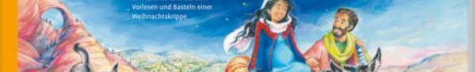
Representations of the Virgin Mary in Swiss German religious school textbooks in a multi-religious society
Bernhard Rotzer | 24.08.2023 | European Conference on Educational Research (ECER) - he Value of Diversity in Education and Educational Research (University of Glasgow)

Slide 2
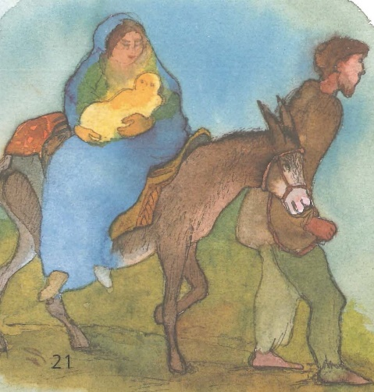
Table of contents
Textbook research
Research interests
Starting point and method
Curriculum 2003
Marian representations (2003 - 2018)
Curriculum 21
Marian representations (from 2018)
Conclusion

